Slide 1

Grading System
By:
Noa, Kenji Isaac W.
Saragpon, Daniel C.
Vibar, Miles Dominic M.
Zurbano, Ian Christopher L.

Slide 2
Introduction

Slide 3
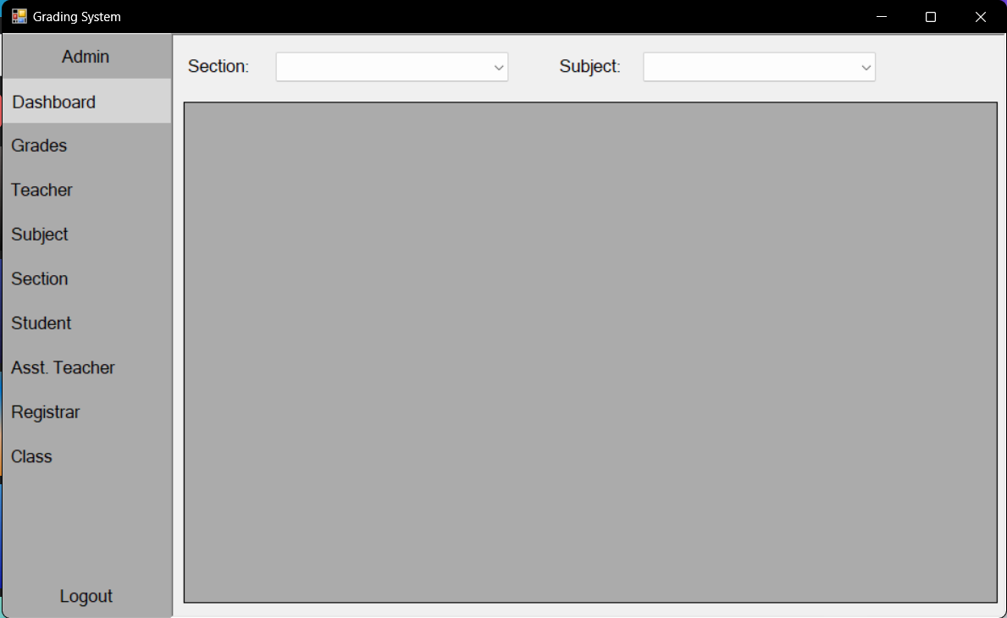
Overview of the Project

Slide 4
Scope

Slide 5
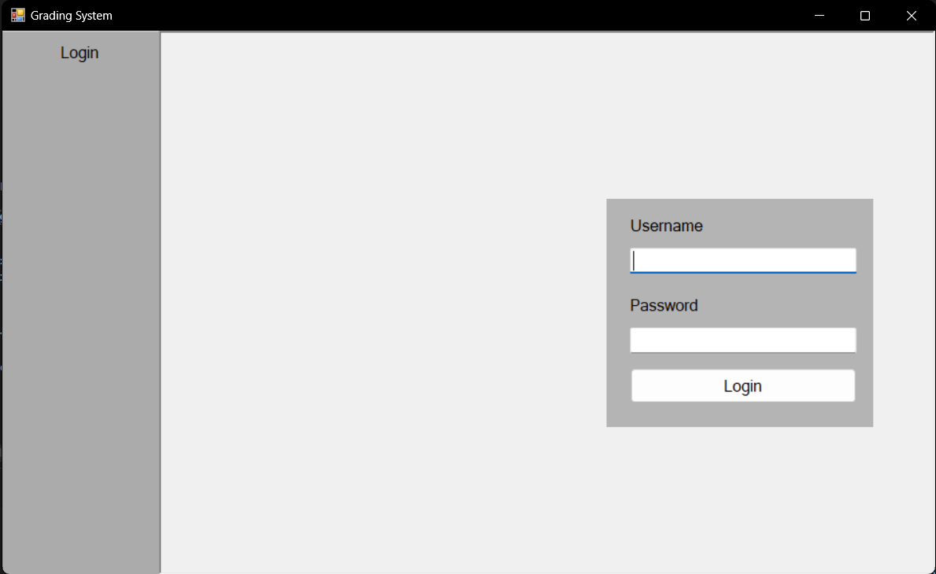
Login Module

Slide 6
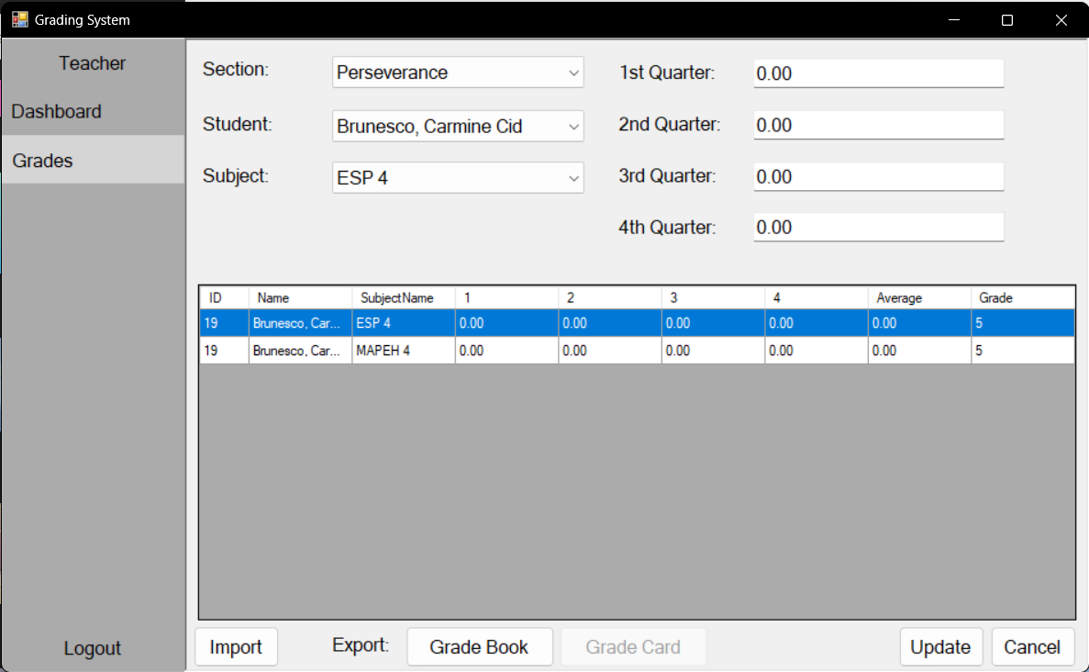
Grades Module

Slide 7
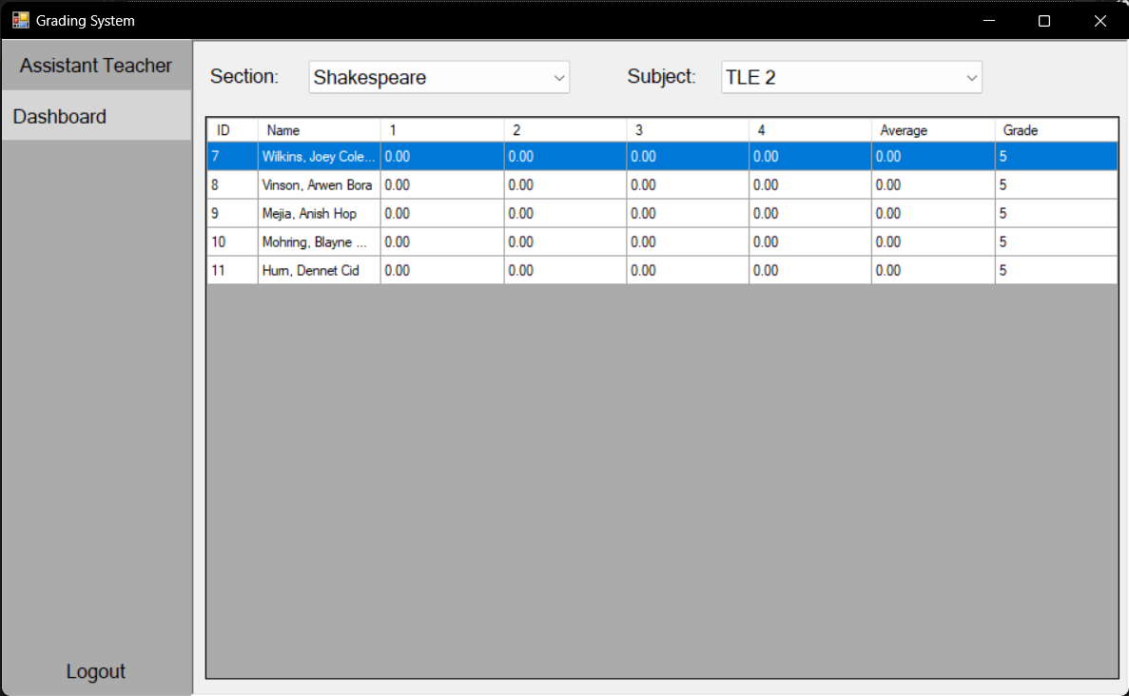
Assistant Teacher Module

Slide 8
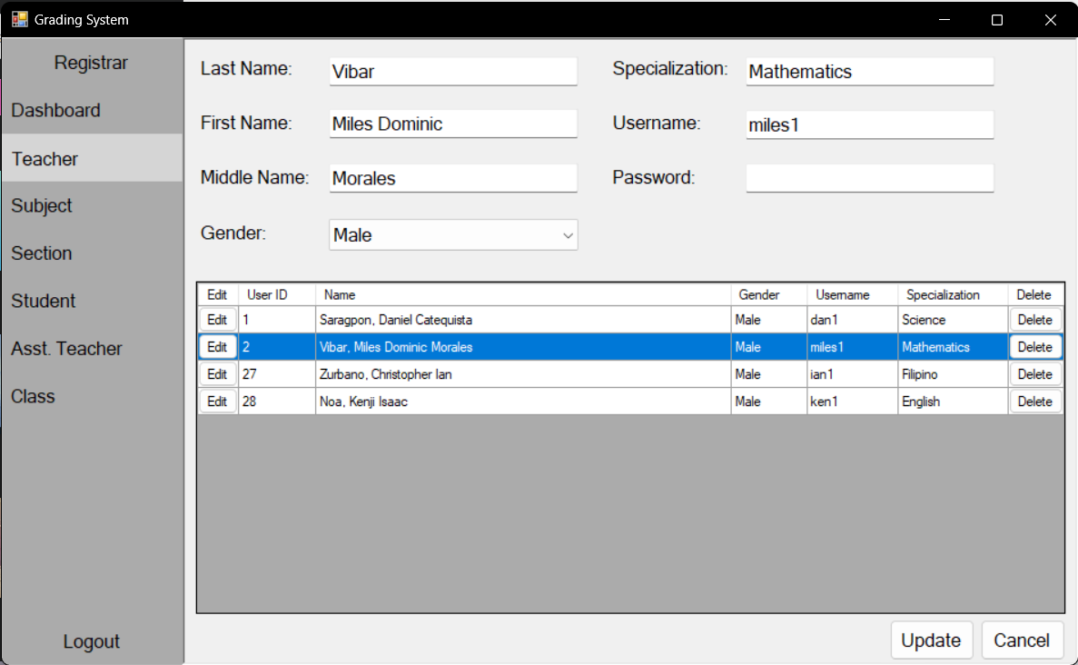
Registrar Module

Slide 9
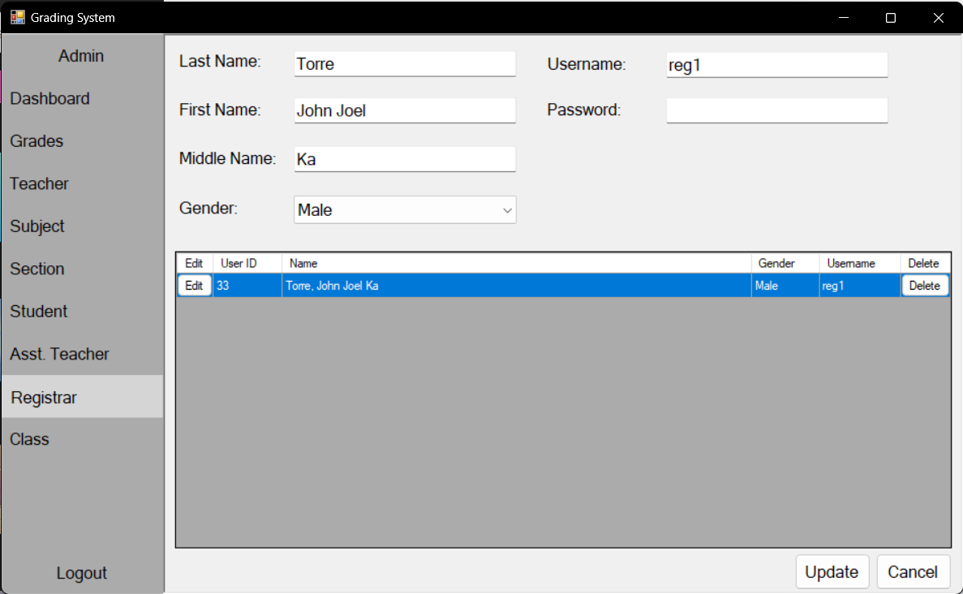
Admin Module

Slide 10
Roles
Super Admin
User Level 2
User Level 1
Registrar
&
Teacher
Assistant Teacher
Admin

Slide 11
Diagrams

Slide 12
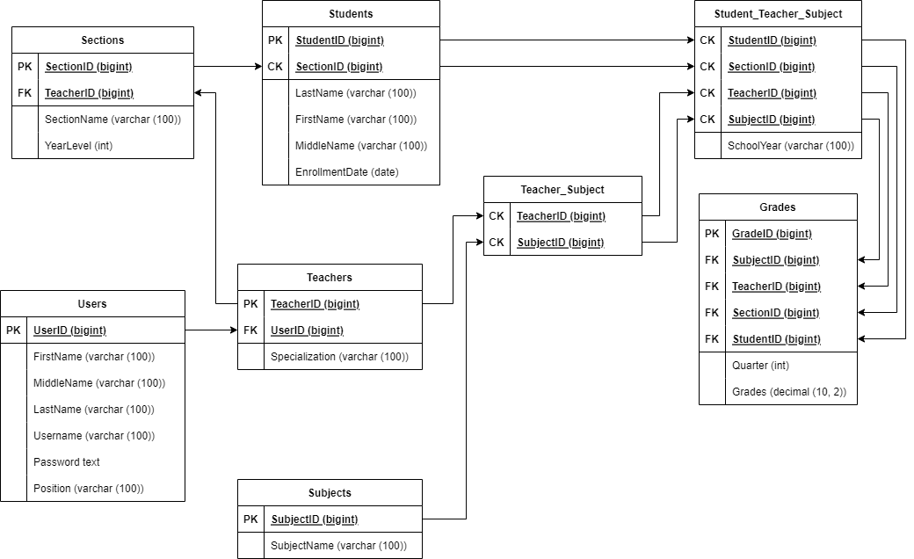
Star Schema

Slide 13
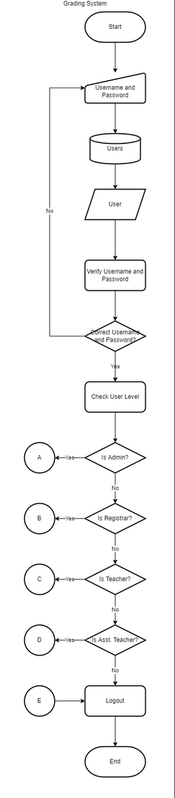
Flowchart

Slide 14
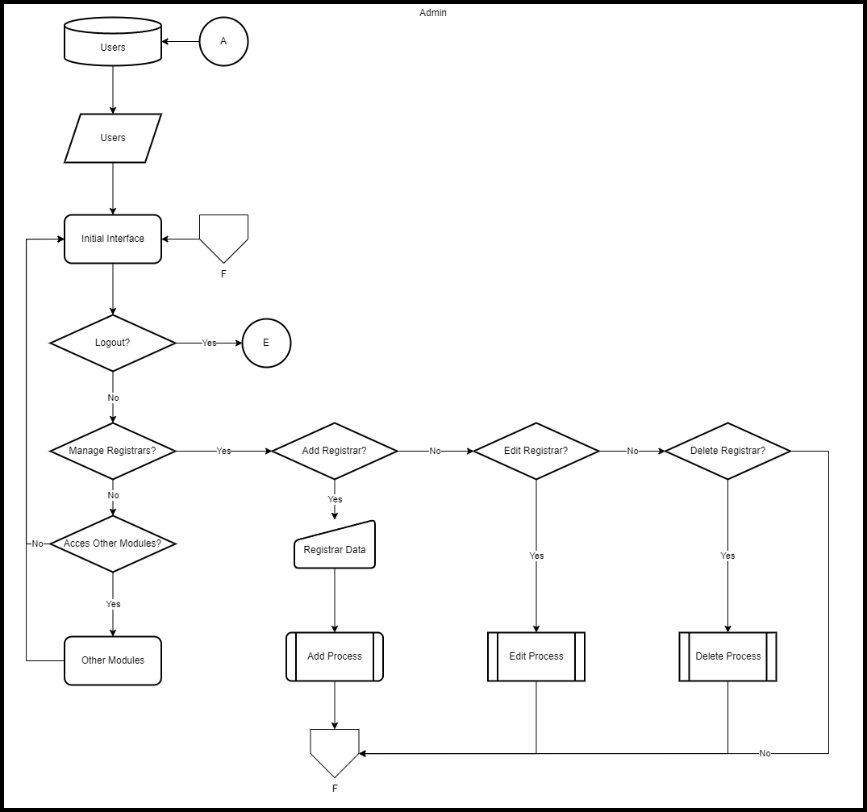
Admin Flowchart

Slide 15
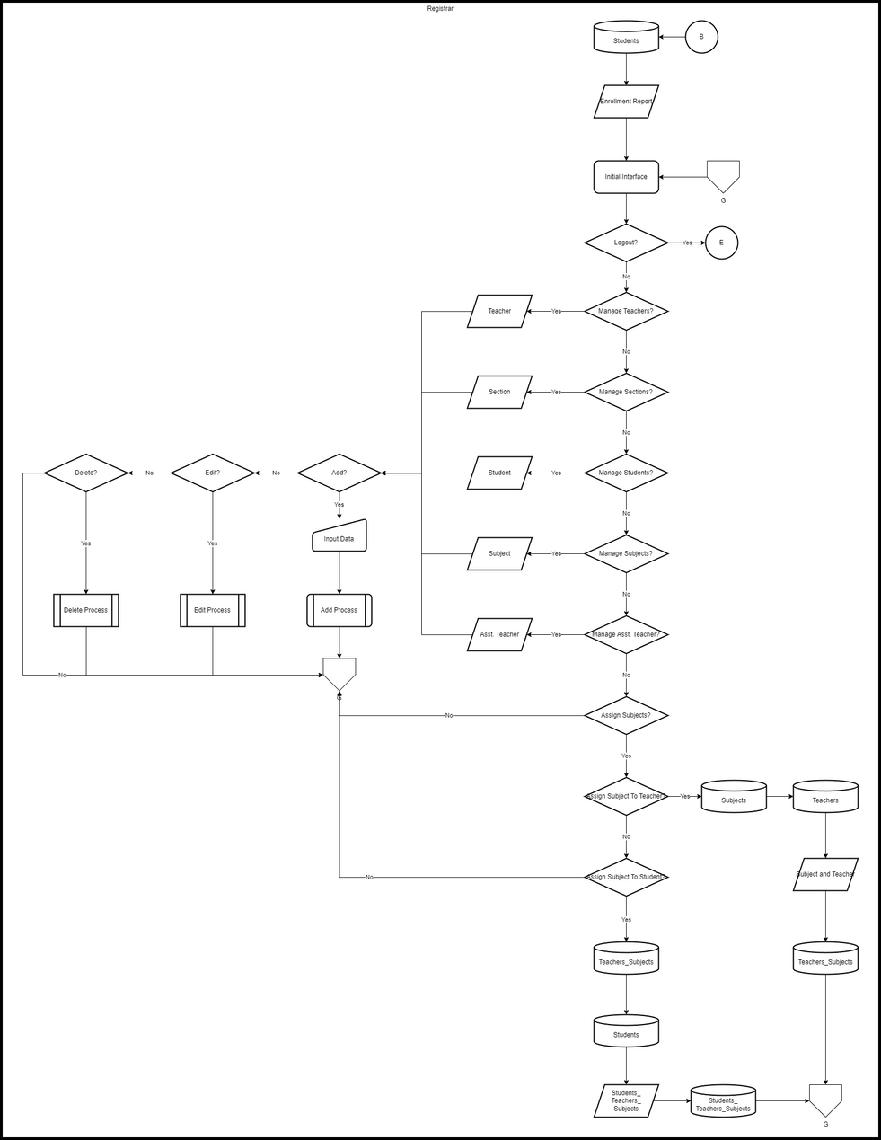
Registrar Flowchart

Slide 16
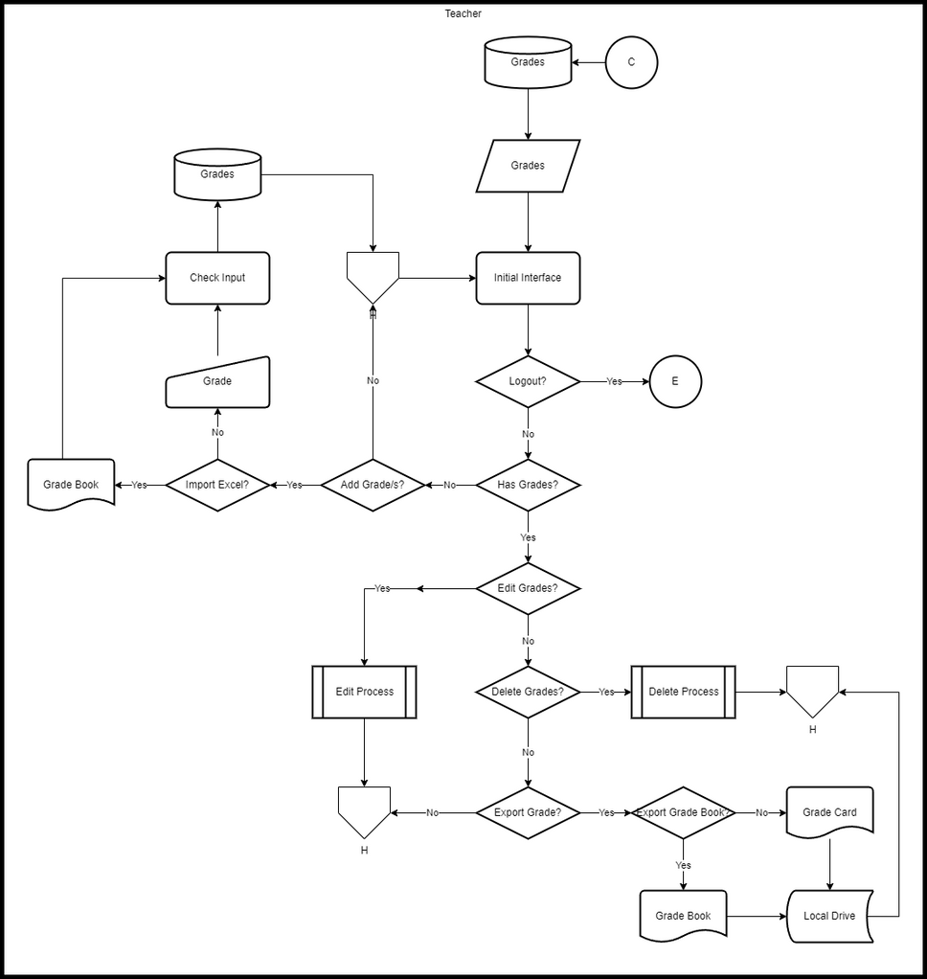
Teacher Flowchart

Slide 17
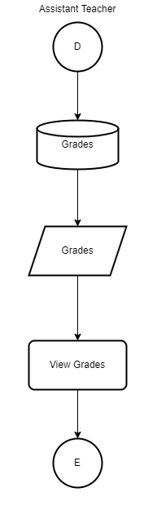
Assistant Teacher Flowchart

Slide 18
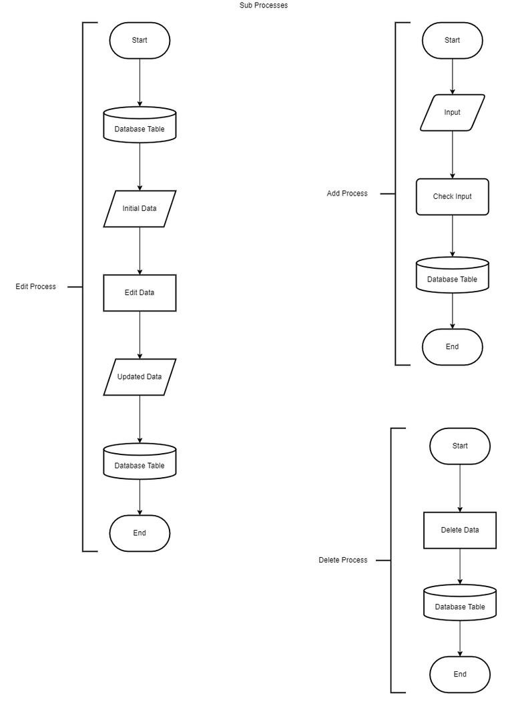
Sub-processes

Slide 19
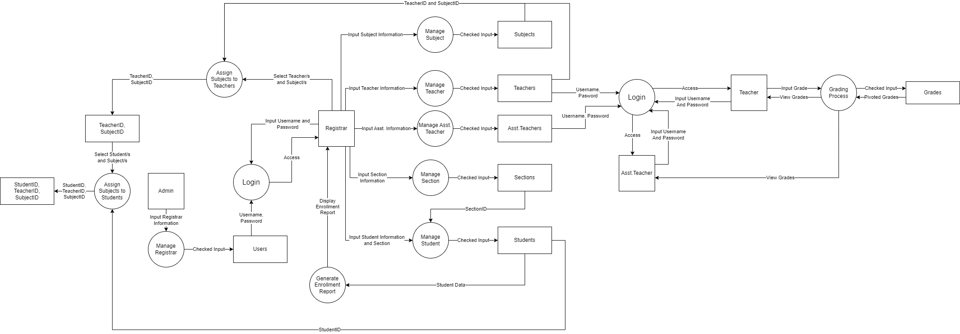
Data Flow Diagram

Slide 20
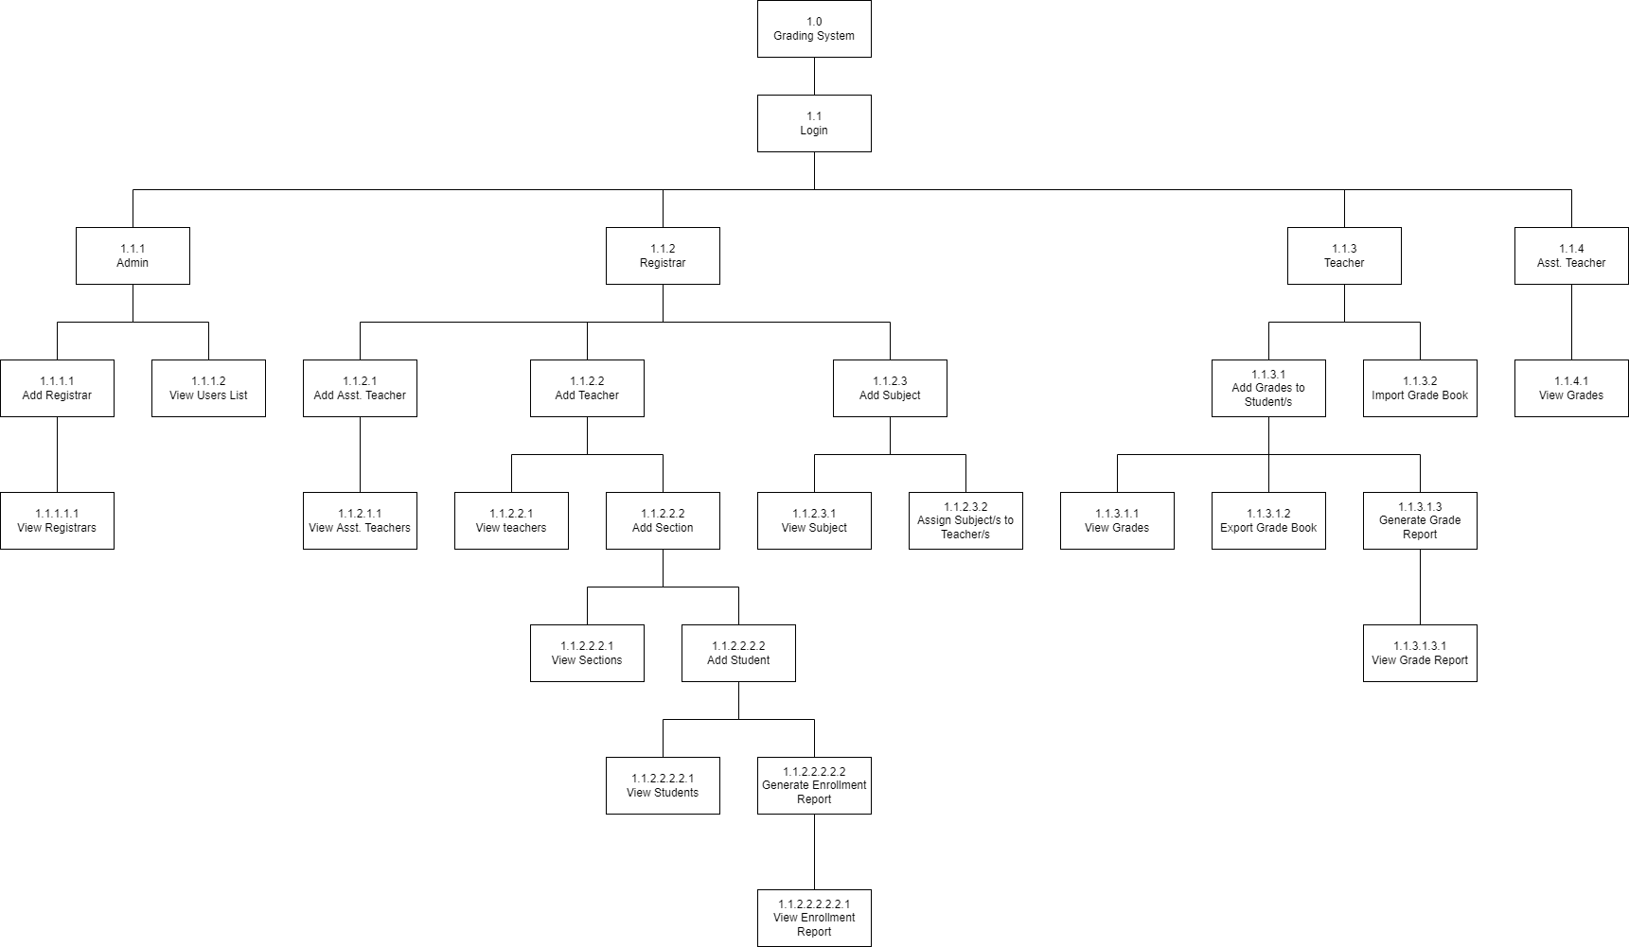
HIPO Diagram

Slide 21
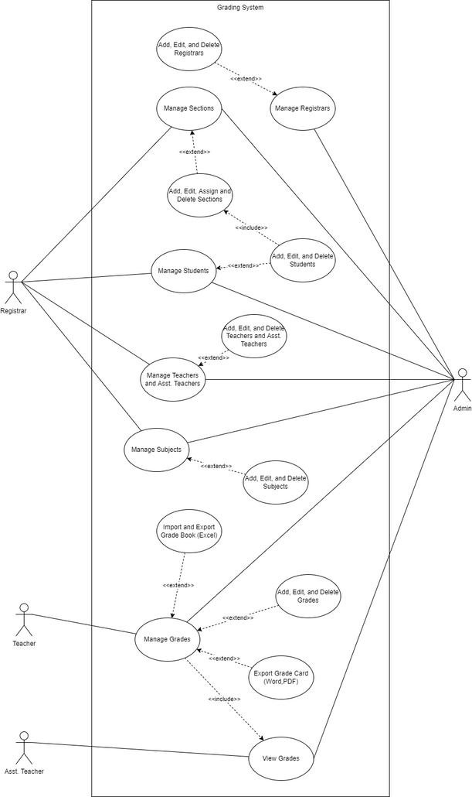
Use Case Diagram

Slide 22
Grading System
By:
Noa, Kenji Isaac W.
Saragpon, Daniel C.
Vibar, Miles Dominic M.
Zurbano, Ian Christopher L.

